Slide 1
St. Louis Central Corridor West Building Permits
Monthly Report: April 2021

Slide 2
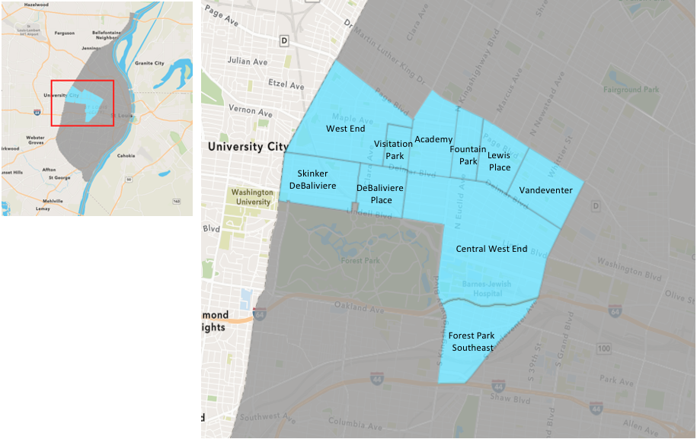
St. Louis Neighborhood Spatial Reference

Slide 3
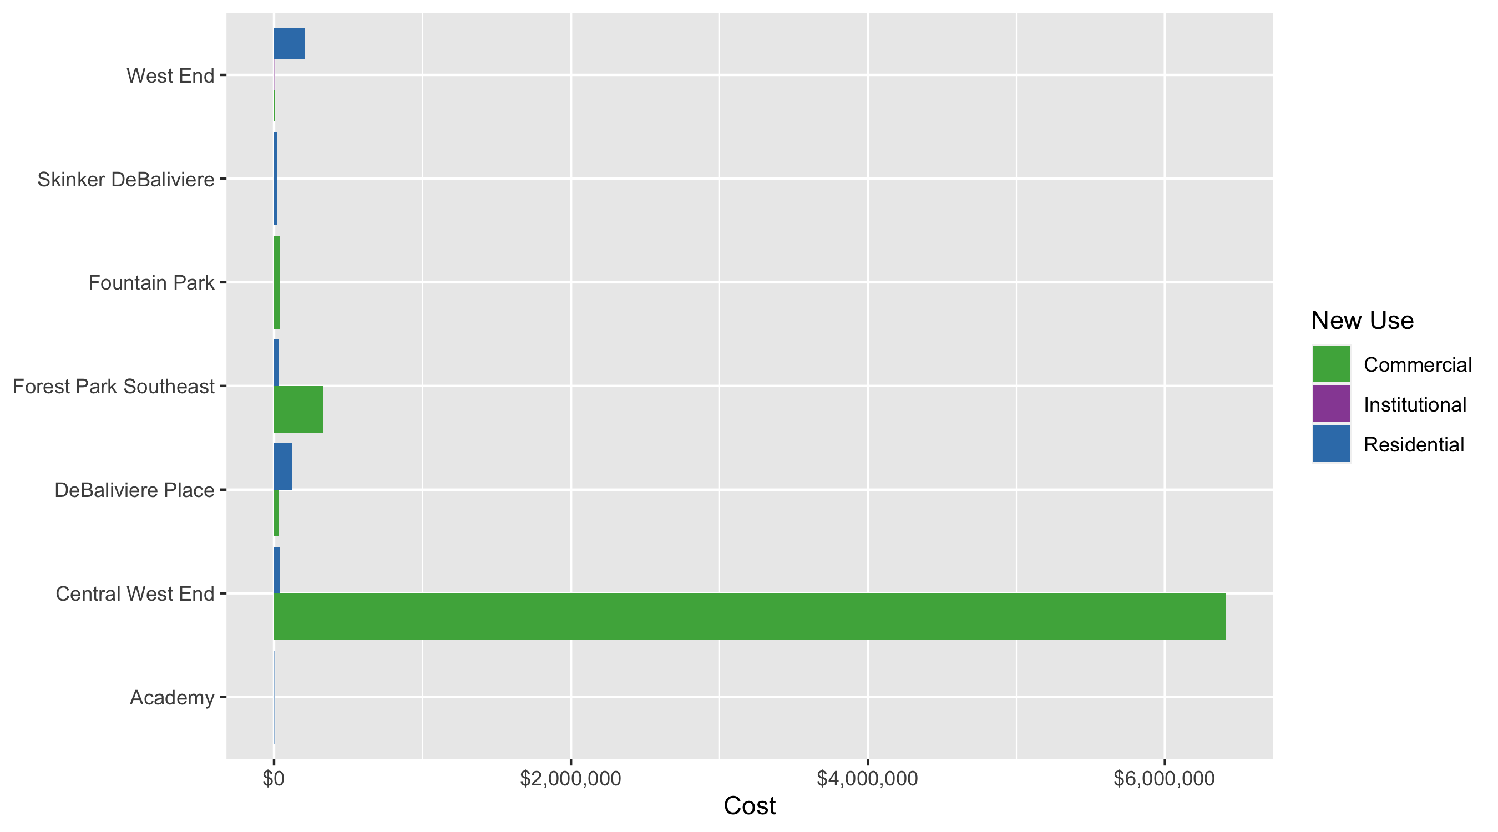
Neighborhood Summary: Average Building Permit Cost

Slide 4
Neighborhood Summary
April 2021 | April 2021 | April 2021 | April 2021
Neighborhood | Average Cost | # of Permits | Total Value of Permits
Academy | $1,838 | 2 | $3,675
Central West End | $3,291,087 | 49 | $161,263,281
DeBaliviere Place | $88,091 | 5 | $440,456
Forest Park Southeast | $170,653 | 11 | $1,877,186
Fountain Park | $35,669 | 1 | $35,669
Lewis Place | $0 | 0 | $0
Skinker DeBaliviere | $22,394 | 8 | $179,154
Vandeventer | $0 | 0 | $0
Visitation Park | $0 | 0 | $0
West End | $152,061 | 15 | $2,280,908
Last 6 Months | Last 6 Months | Last 6 Months | Last 6 Months
Neighborhood | Average Cost | # of Permits | Total Value of Permits
Academy | $50,441 | 16 | $807,059
Central West End | $1,509,729 | 217 | $327,611,126
DeBaliviere Place | $91,299 | 30 | $2,738,962
Forest Park Southeast | $360,622 | 73 | $26,325,410
Fountain Park | $584,933 | 11 | $6,434,264
Lewis Place | $12,771 | 10 | $127,706
Skinker DeBaliviere | $130,030 | 51 | $6,631,543
Vandeventer | $6,000 | 1 | $6,000
Visitation Park | $670,091 | 3 | $2,010,274
West End | $91,662 | 54 | $4,949,739

Slide 5
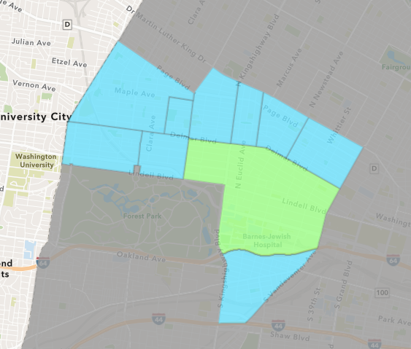
Central West End
April 2021 Neighborhood Cost Breakdown
Mean: $3,291,087
Median: $19,000
Range: $1,900 - $151,000,000

Slide 6
Central West End: Summary Notes
49 building permits in April 2021
104.17% change compared to April 2020 (24 total building permits)
$3,291,087: Average building permit cost in April 2021
5530.10% change compared to April 2020 ($58,455)
153 total building permits in 2021
14.18% change YTD compared to this time in 2020 (134 total building permits)
$1,886,165: YTD average building permit cost in 2021
934.10% change YTD compared to this time in 2020 ($182,397)

Slide 7
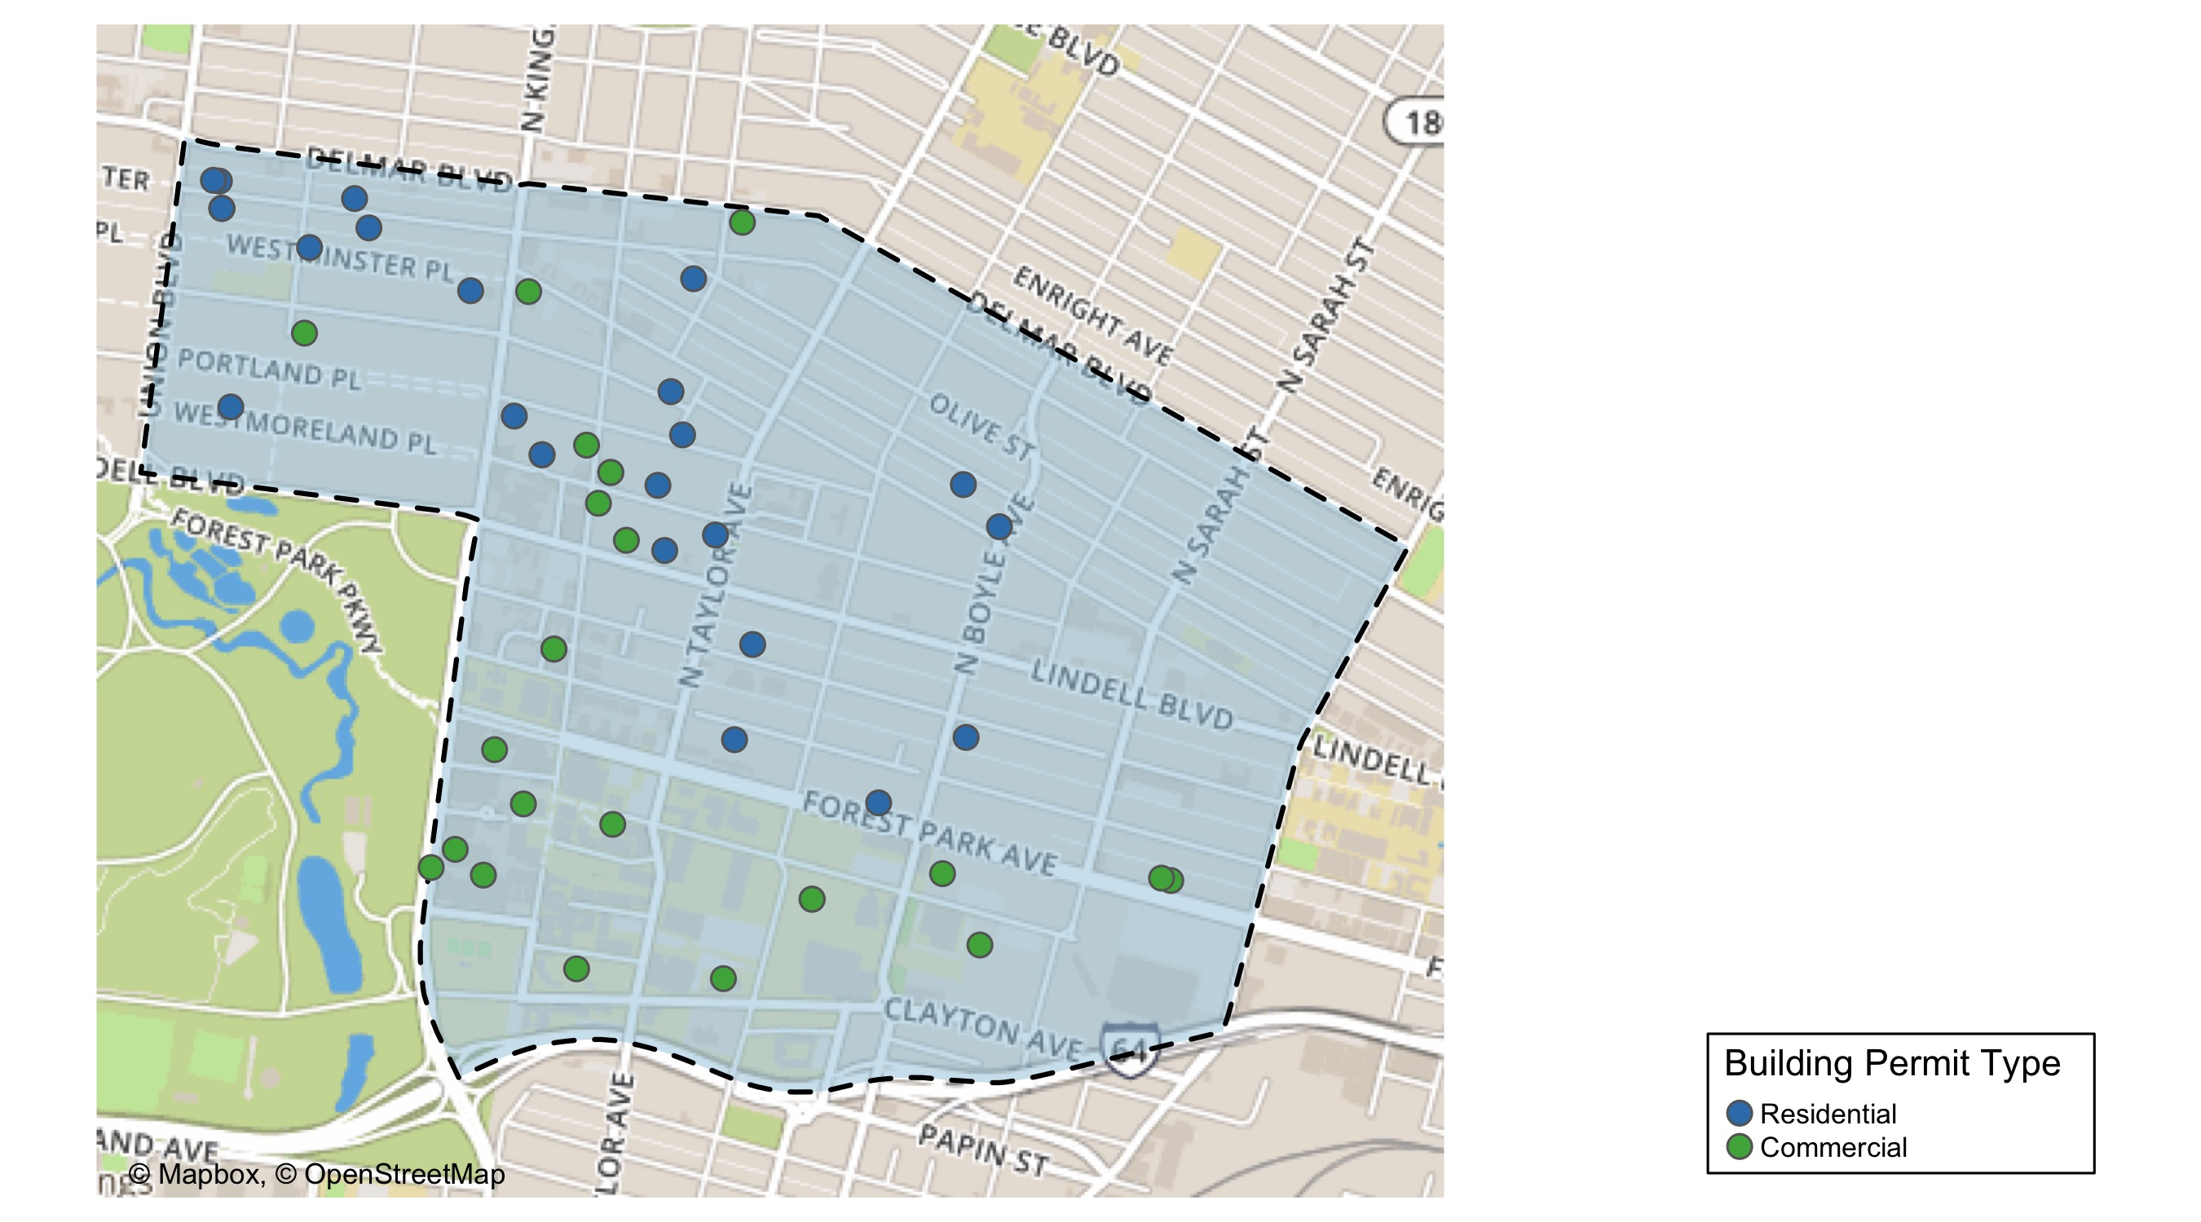
Central West End

Slide 8
Neighborhood Summary
April 2021 | April 2021 | April 2021 | April 2021
Permit Use | Average Cost | # of Permits | Total Value of Permits
Commercial | $6,411,135 | 25 | $160,278,371
Industrial | $0 | 0 | $0
Institutional | $0 | 0 | $0
Residential | $41,038 | 24 | $984,910
Last 6 Months | Last 6 Months | Last 6 Months | Last 6 Months
Permit Use | Average Cost | # of Permits | Total Value of Permits
Commercial | $2,926,397 | 95 | $278,007,742
Industrial | $0 | 0 | $0
Institutional | $70,090 | 12 | $841,086
Residential | $443,294 | 110 | $48,762,298

Slide 9
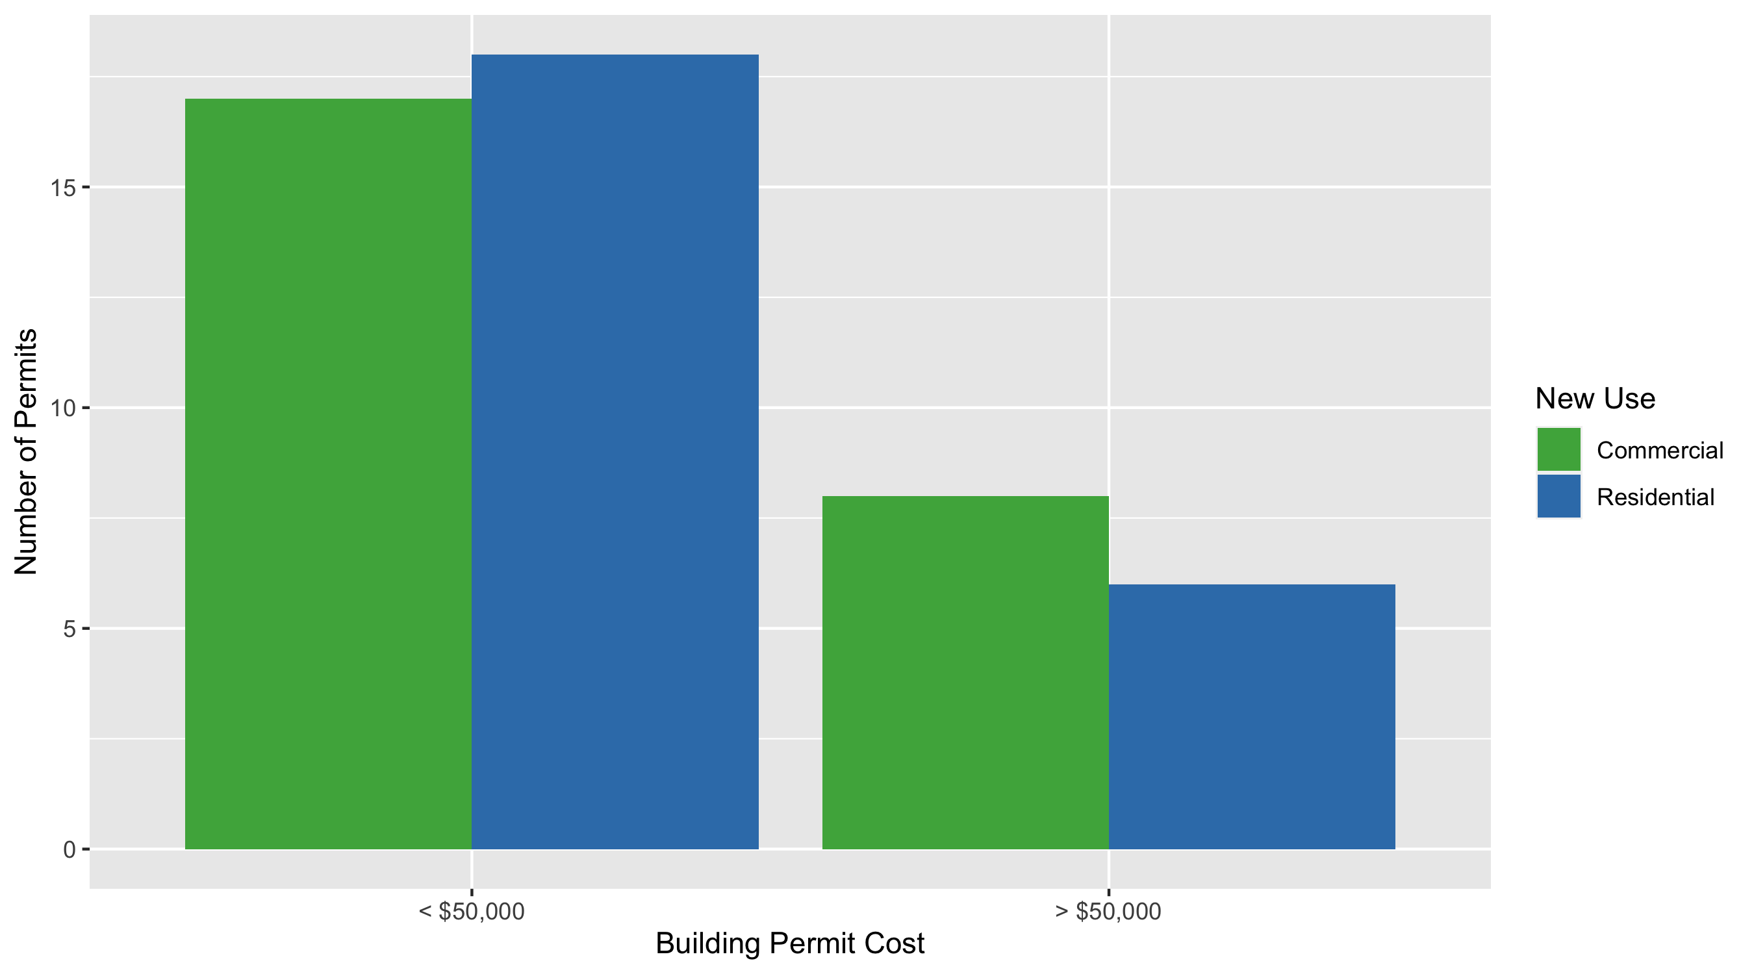
Central West End Permit Cost Breakdown

Slide 10
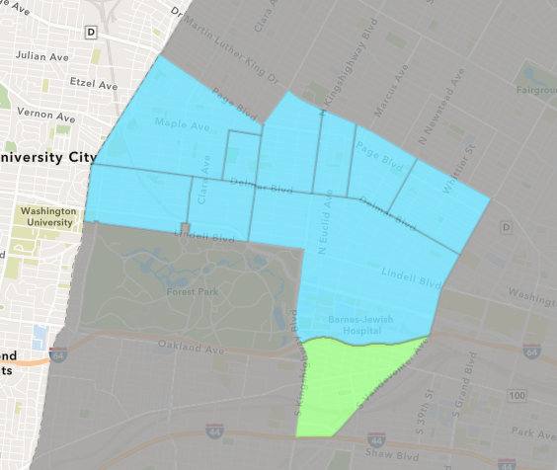
Forest Park Southeast
April 2021 Neighborhood Cost Breakdown
Mean: $170,653
Median: $10,000
Range: $200 - $951,386

Slide 11
Forest Park Southeast: Summary Notes
11 building permits in April 2021
-15.38% change compared to April 2020 (13 total building permits)
$170,653: Average building permit cost in April 2021
309.16% change compared to April 2020 ($41,708)
56 total building permits in 2021
64.71% change YTD compared to this time in 2020 (34 total building permits)
$107,444: YTD average building permit cost in 2021
84.47% change YTD compared to this time in 2020 ($58,245)

Slide 12
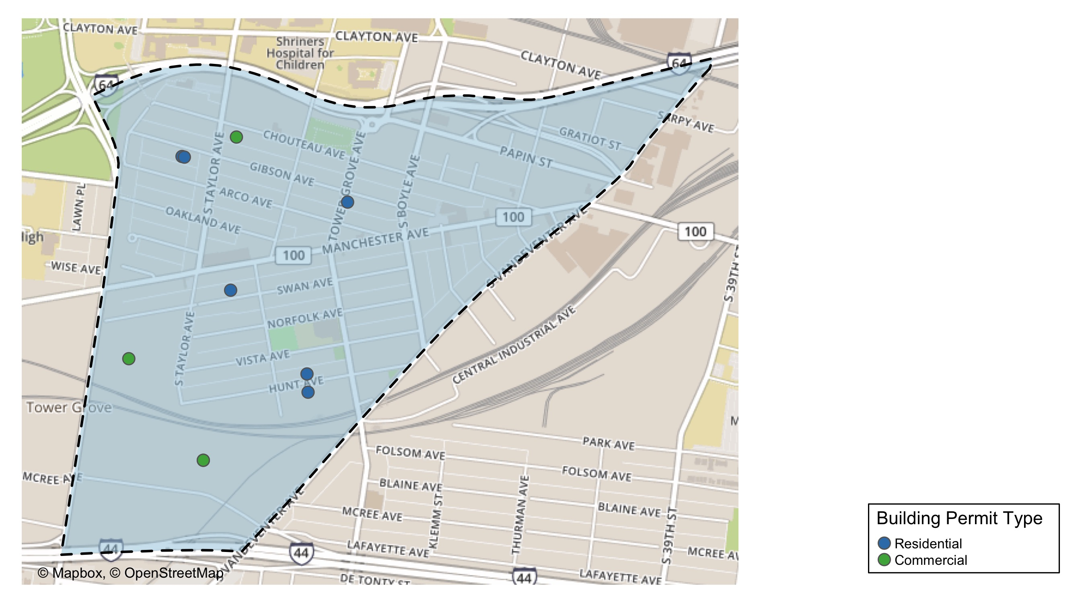
Forest Park Southeast

Slide 13
Neighborhood Summary
April 2021 | April 2021 | April 2021 | April 2021
Permit Use | Average Cost | # of Permits | Total Value of Permits
Commercial | $333,717 | 5 | $1,668,586
Industrial | $0 | 0 | $0
Institutional | $0 | 0 | $0
Residential | $34,767 | 6 | $208,600
Last 6 Months | Last 6 Months | Last 6 Months | Last 6 Months
Permit Use | Average Cost | # of Permits | Total Value of Permits
Commercial | $142,890 | 25 | $3,572,260
Industrial | $0 | 0 | $0
Institutional | $0 | 0 | $0
Residential | $474,024 | 48 | $22,753,150

Slide 14
Forest Park Southeast Individual Permit Breakdown
Owner | New Use | Cost | address
SWAN 2020 LLC | Residential | $120,000 | 4427 SWAN AV
GREEN ST 4565 MCREE INVESTORS LLC AT | Commercial | $700,000 | 4565 MCREE AV
WASHINGTON UNIVERSITY | Commercial | $951,386 | 1234 S KINGSHIGHWAY BLVD
GREEN STREET MCREE INVESTORS LLC | Commercial | $15,000 | 4591 MCREE AV
DIEKEMPER, JOSEPH D & REBECCA L | Residential | $2,600 | 4528 GIBSON AV
GREEN STREET MCREE INVESTORS LLC | Commercial | $200 | 4591 MCREE AV
CAMPBELL, JEFFREY S & INGRID | Commercial | $2,000 | 4464 CHOUTEAU AV
PARK SOUTH PROPERTIES LLC | Residential | $75,000 | 4352 GIBSON AV
ANZAC DEVELOPMENTS LLC | Residential | $10,000 | 4343 HUNT AV
WOOD, DANIEL W | Residential | $700 | 4342 HUNT AV
KIRKWOOD, MEGHAN L E & LUCAS G GUARD | Residential | $300 | 4530 GIBSON AV

Slide 15
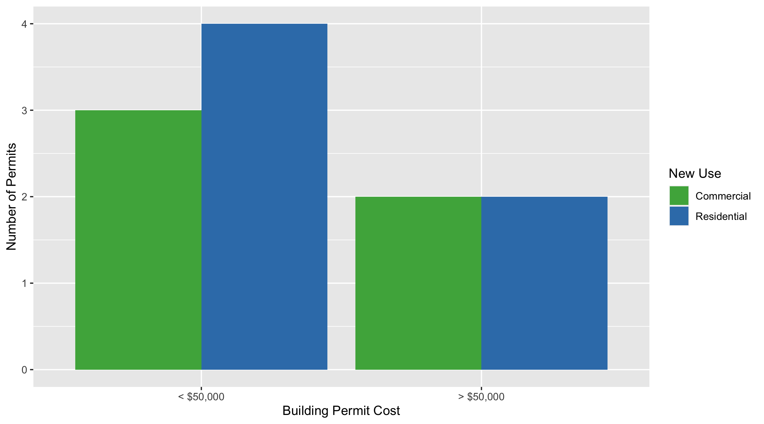
Forest Park Southeast Permit Cost Breakdown

Slide 16
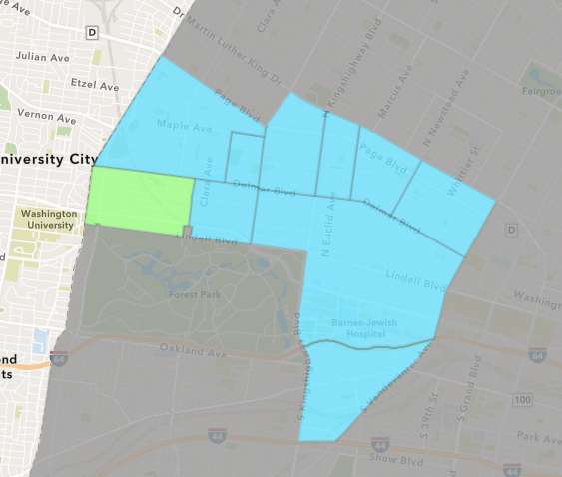
Skinker DeBaliviere
April 2021 Neighborhood Cost Breakdown
Mean: $22,394
Median: $16,927
Range: $2,000 - $80,000

Slide 17
Skinker DeBaliviere: Summary Notes
8 building permits in April 2021
-27.27% change compared to April 2020 (11 total building permits)
$22,394: Average building permit cost in April 2021
-99.56% change compared to April 2020 ($5,112,792)
36 total building permits in 2021
-21.74% change YTD compared to this time in 2020 (46 total building permits)
$172,382: YTD average building permit cost in 2021
-86.05% change YTD compared to this time in 2020 ($1,235,923)

Slide 18
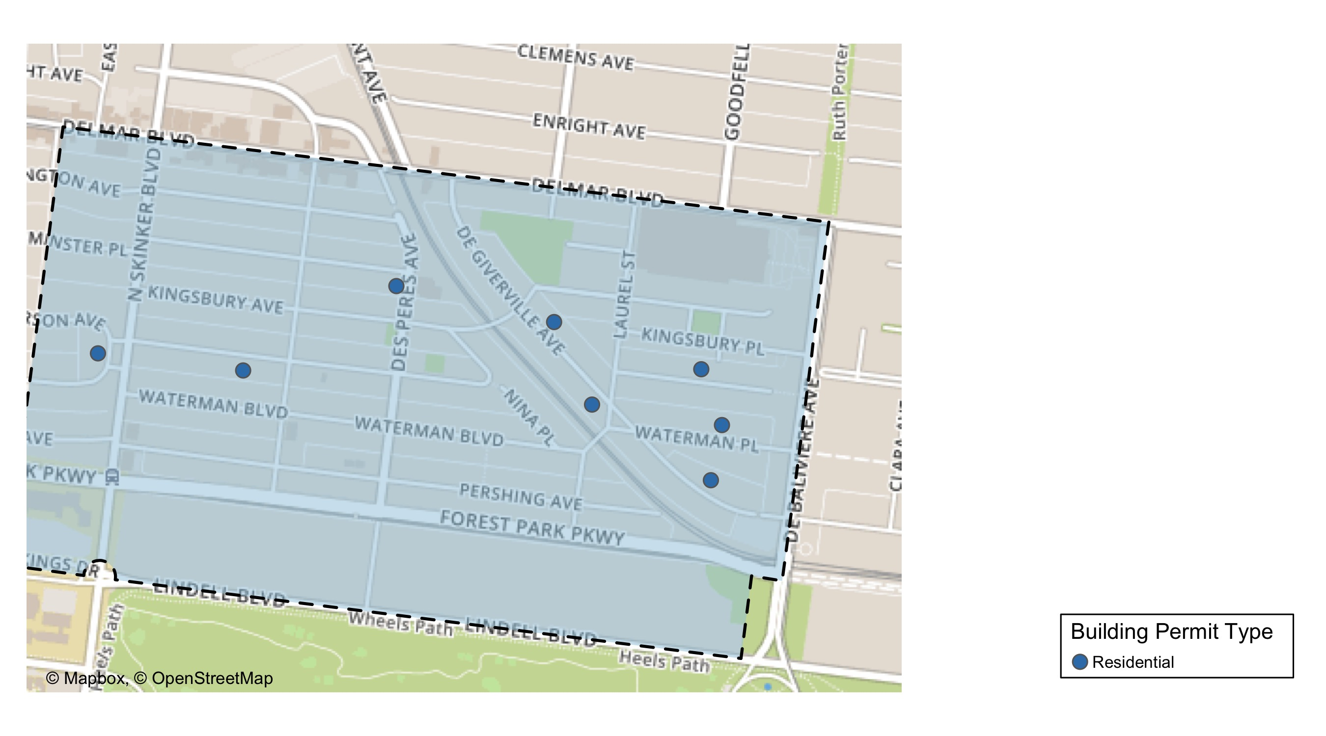
Skinker DeBaliviere

Slide 19
Neighborhood Summary
April 2021 | April 2021 | April 2021 | April 2021
Permit Use | Average Cost | # of Permits | Total Value of Permits
Commercial | $0 | 0 | $0
Industrial | $0 | 0 | $0
Institutional | $0 | 0 | $0
Residential | $22,394 | 8 | $179,154
Last 6 Months | Last 6 Months | Last 6 Months | Last 6 Months
Permit Use | Average Cost | # of Permits | Total Value of Permits
Commercial | $11,110 | 5 | $55,548
Industrial | $0 | 0 | $0
Institutional | $0 | 0 | $0
Residential | $142,956 | 46 | $6,575,995

Slide 20
Skinker DeBaliviere Individual Permit Breakdown
Owner | New Use | Cost | address
BARTON, JONATHAN T & JENNIFER L | Residential | $23,400 | 6200 MCPHERSON AV
HARSLEY, RACHEL E | Residential | $5,500 | 6006 WESTMINSTER PL
TOPPS, DOVIE M | Residential | $10,454 | 5747 WATERMAN BLVD
MENDICINO ENTERPRISES LLC | Residential | $25,000 | 6126 MCPHERSON AV
VAN BEURDEN, MARK & ASHLEY BRESSMER | Residential | $2,000 | 5855 DEGIVERVILLE AV
GLOBAL INVESTMENT GROUP LLC | Residential | $28,000 | 5765 MCPHERSON AV
ELOSIEBO, MECHELLE & | Residential | $80,000 | 5806 DEGIVERVILLE AV
ROTHSCHILD, M DAVID III | Residential | $4,800 | 5755 DEGIVERVILLE AV

Slide 21
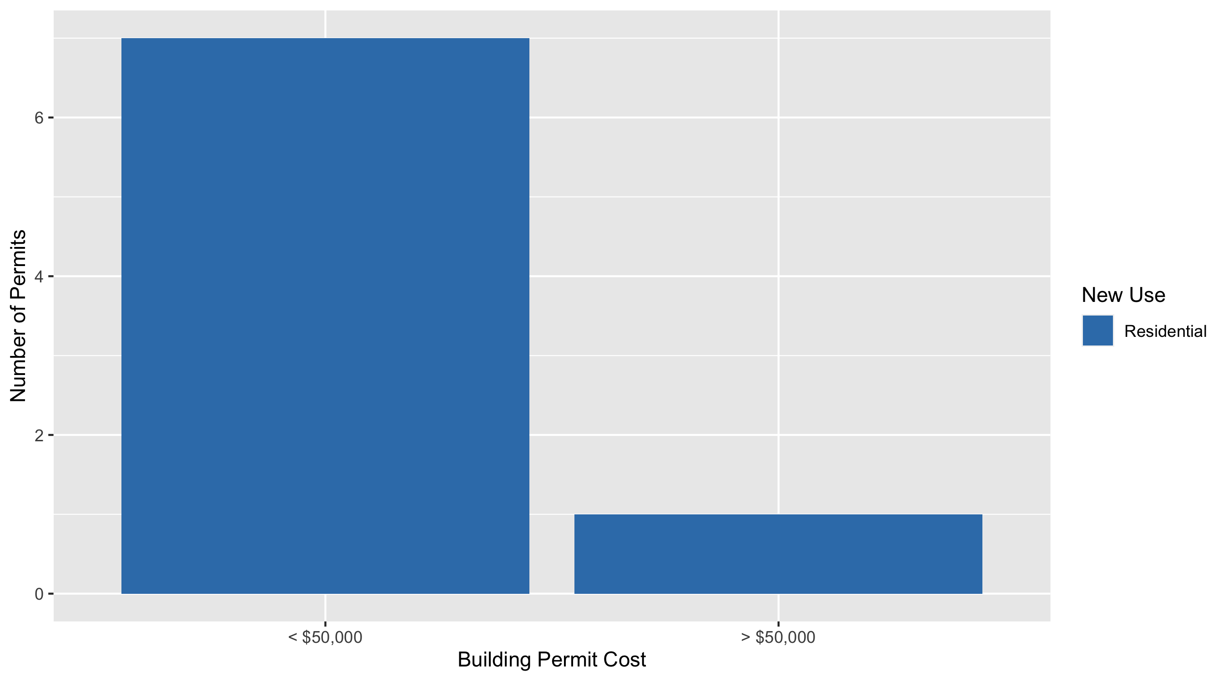
Skinker DeBaliviere Permit Cost Breakdown

Slide 22
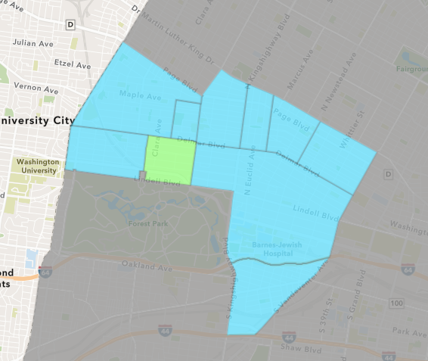
DeBaliviere Place
April 2021 Neighborhood Cost Breakdown
Mean: $88,091
Median: $54,919
Range: $3,396 - $275,000

Slide 23
DeBaliviere Place: Summary Notes
5 building permits in April 2021
25.00% change compared to April 2020 (4 total building permits)
$88,091: Average building permit cost in April 2021
-87.86% change compared to April 2020 ($725,614)
16 total building permits in 2021
33.33% change YTD compared to this time in 2020 (12 total building permits)
$76,719: YTD average building permit cost in 2021
-70.83% change YTD compared to this time in 2020 ($263,005)

Slide 24
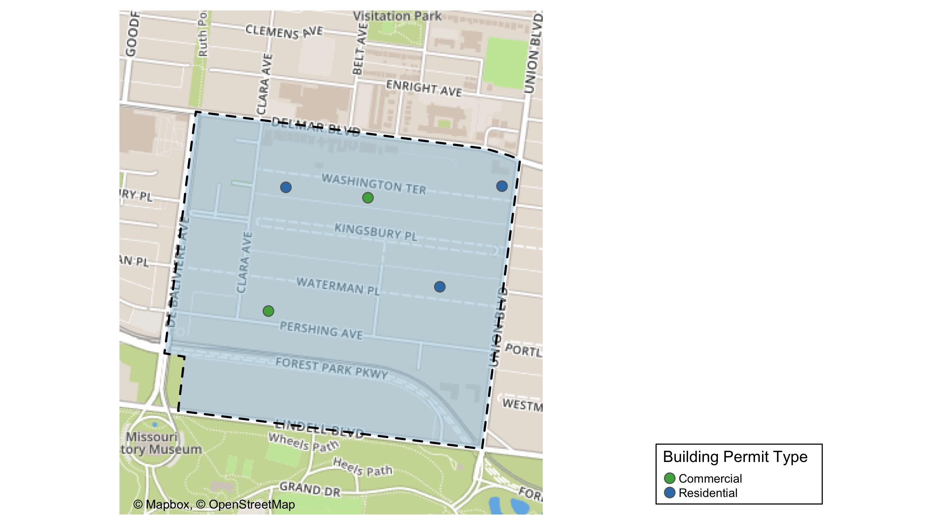
DeBaliviere Place

Slide 25
Neighborhood Summary
April 2021 | April 2021 | April 2021 | April 2021
Permit Use | Average Cost | # of Permits | Total Value of Permits
Commercial | $33,448 | 2 | $66,896
Industrial | $0 | 0 | $0
Institutional | $0 | 0 | $0
Residential | $124,520 | 3 | $373,560
Last 6 Months | Last 6 Months | Last 6 Months | Last 6 Months
Permit Use | Average Cost | # of Permits | Total Value of Permits
Commercial | $45,149 | 6 | $270,896
Industrial | $0 | 0 | $0
Institutional | $0 | 0 | $0
Residential | $102,836 | 24 | $2,468,066

Slide 26
DeBaliviere Place Individual Permit Breakdown
Owner | New Use | Cost | address
KATIE ADASTRA & BARTHOLOMEW ADASTRA | Residential | $275,000 | 44 WASHINGTON TER
SERVICE EMPLOYEES INTERNATIONAL UNIO | Commercial | $3,396 | 5585 PERSHING AV
BURKER, TIMOTHY ROBERT & | Residential | $54,919 | 1 WASHINGTON TER
O'DELL, DALE A & JENNIFER TRS | Commercial | $63,500 | 30 WASHINGTON TER
NASH, ALISON C & CLARENCE E DULA | Residential | $43,641 | 57 WATERMAN PL

Slide 27
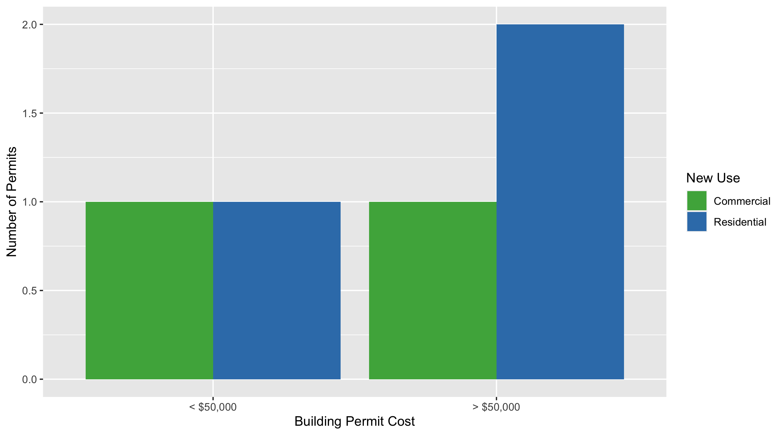
DeBaliviere Place Permit Cost Breakdown

Slide 28
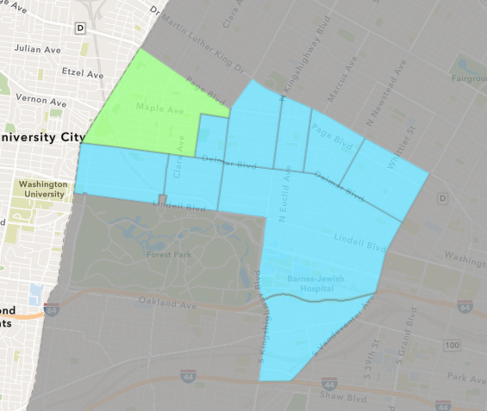
West End
April 2021 Neighborhood Cost Breakdown
Mean: $152,061
Median: $15,000
Range: $1,700 - $1,280,000

Slide 29
West End: Summary Notes
15 building permits in April 2021
400.00% change compared to April 2020 (3 total building permits)
$152,061: Average building permit cost in April 2021
-95.20% change compared to April 2020 ($3,168,200)
38 total building permits in 2021
46.15% change YTD compared to this time in 2020 (26 total building permits)
$105,767: YTD average building permit cost in 2021
-73.56% change YTD compared to this time in 2020 ($399,977)

Slide 30
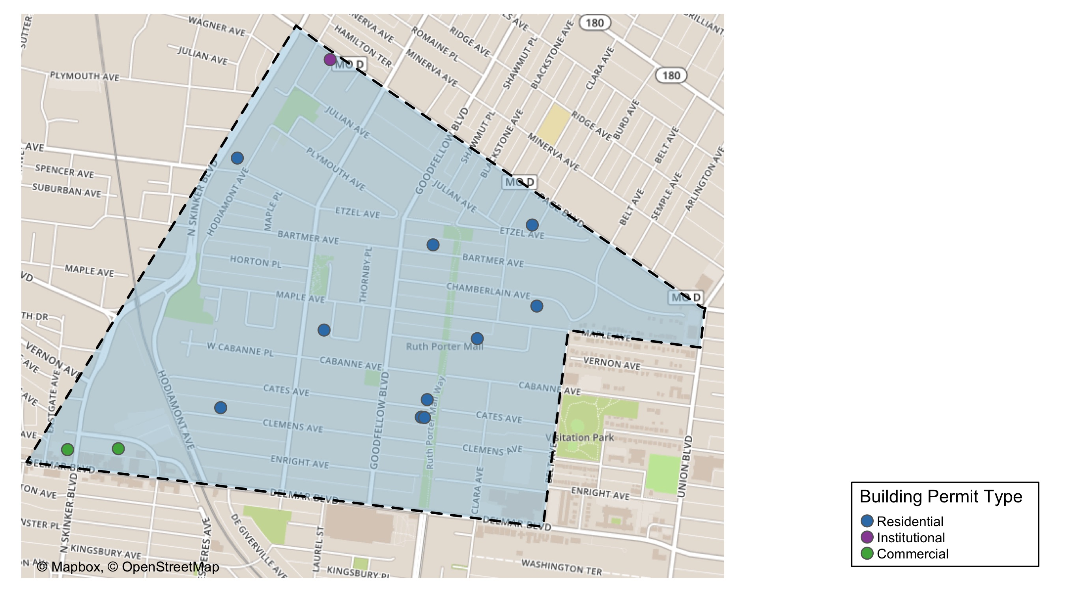
West End

Slide 31
Neighborhood Summary
April 2021 | April 2021 | April 2021 | April 2021
Permit Use | Average Cost | # of Permits | Total Value of Permits
Commercial | $6,767 | 3 | $20,300
Industrial | $0 | 0 | $0
Institutional | $1,700 | 1 | $1,700
Residential | $205,355 | 11 | $2,258,908
Last 6 Months | Last 6 Months | Last 6 Months | Last 6 Months
Permit Use | Average Cost | # of Permits | Total Value of Permits
Commercial | $38,369 | 10 | $383,688
Industrial | $0 | 0 | $0
Institutional | $1,700 | 1 | $1,700
Residential | $106,148 | 43 | $4,564,351

Slide 32
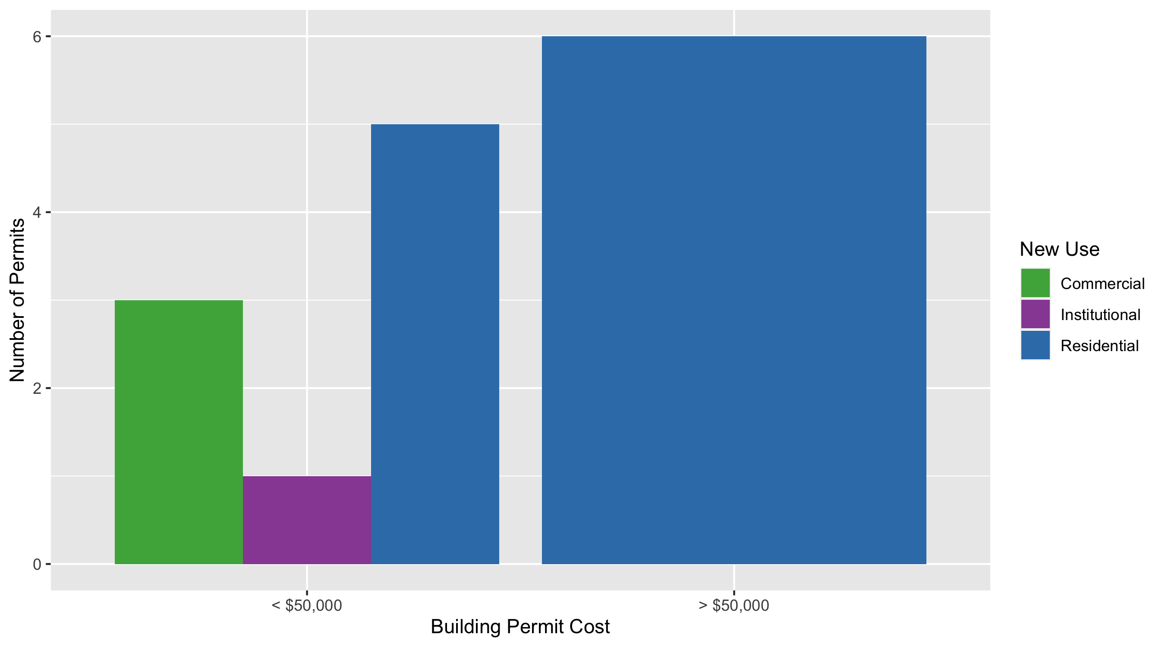
West End Permit Cost Breakdown

Slide 33
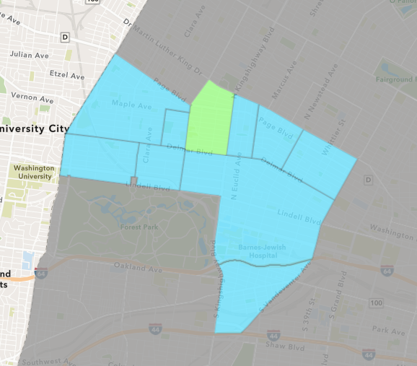
Academy
April 2021 Neighborhood Cost Breakdown
Mean: $1,838
Median: $1,838
Range: $1,375 - $2,300

Slide 34
Academy: Summary Notes
2 building permits in April 2021
-33.33% change compared to April 2020 (3 total building permits)
$1,838: Average building permit cost in April 2021
-96.91% change compared to April 2020 ($59,400)
7 total building permits in 2021
-46.15% change YTD compared to this time in 2020 (13 total building permits)
$81,793: YTD average building permit cost in 2021
0.96% change YTD compared to this time in 2020 ($81,012)

Slide 35
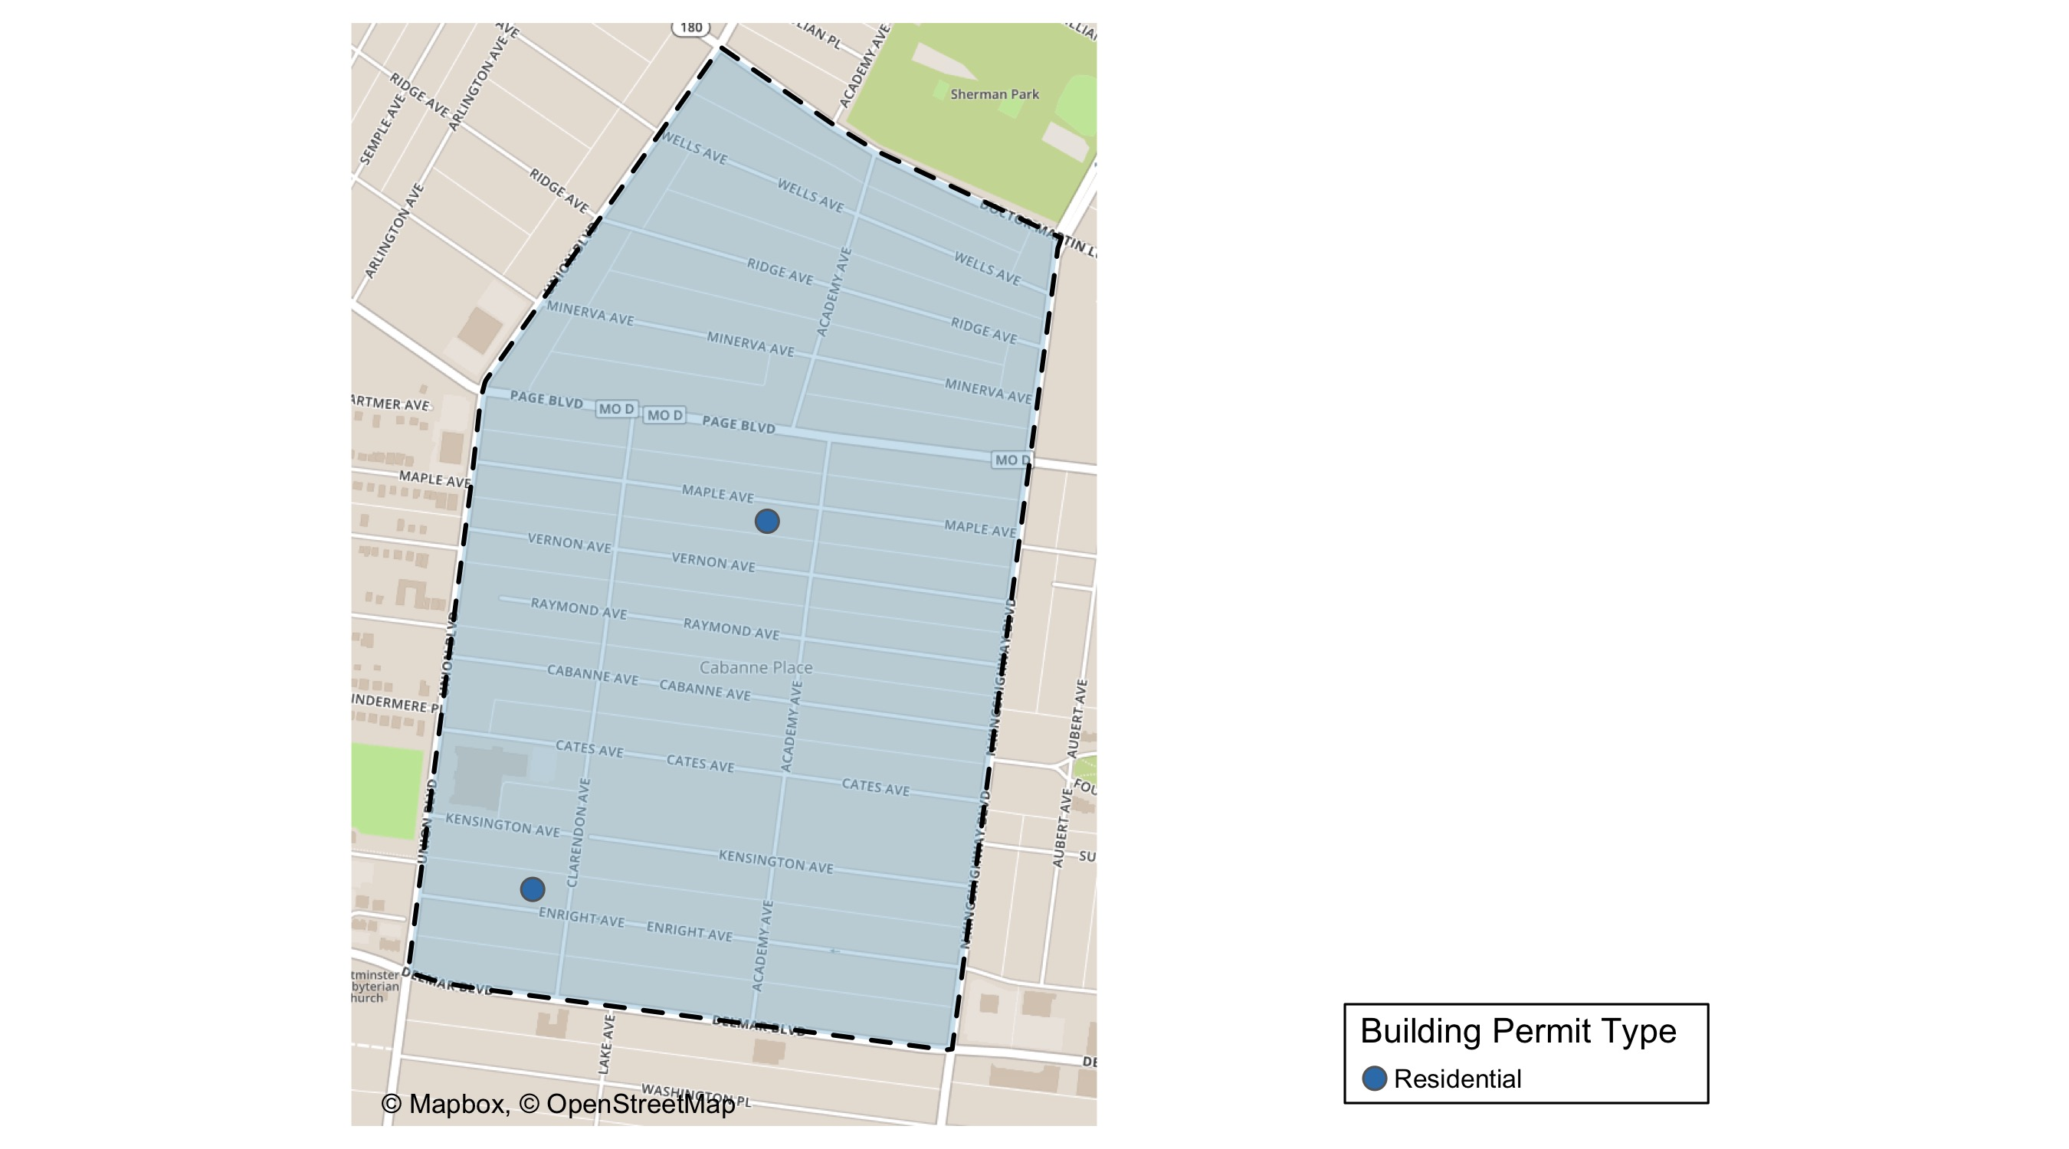
Academy

Slide 36
Neighborhood Summary
April 2021 | April 2021 | April 2021 | April 2021
Permit Use | Average Cost | # of Permits | Total Value of Permits
Commercial | $0 | 0 | $0
Industrial | $0 | 0 | $0
Institutional | $0 | 0 | $0
Residential | $1,838 | 2 | $3,675
Last 6 Months | Last 6 Months | Last 6 Months | Last 6 Months
Permit Use | Average Cost | # of Permits | Total Value of Permits
Commercial | $30,250 | 4 | $121,000
Industrial | $0 | 0 | $0
Institutional | $0 | 0 | $0
Residential | $57,172 | 12 | $686,059

Slide 37
Academy Individual Permit Breakdown
Owner | New Use | Cost | address
RUDOAS URBAN UTOPIA LLC | Residential | $2,300 | 5120 MAPLE AV
SYMS, MELBA DEE JOHNSON | Residential | $1,375 | 5217 ENRIGHT AV

Slide 38
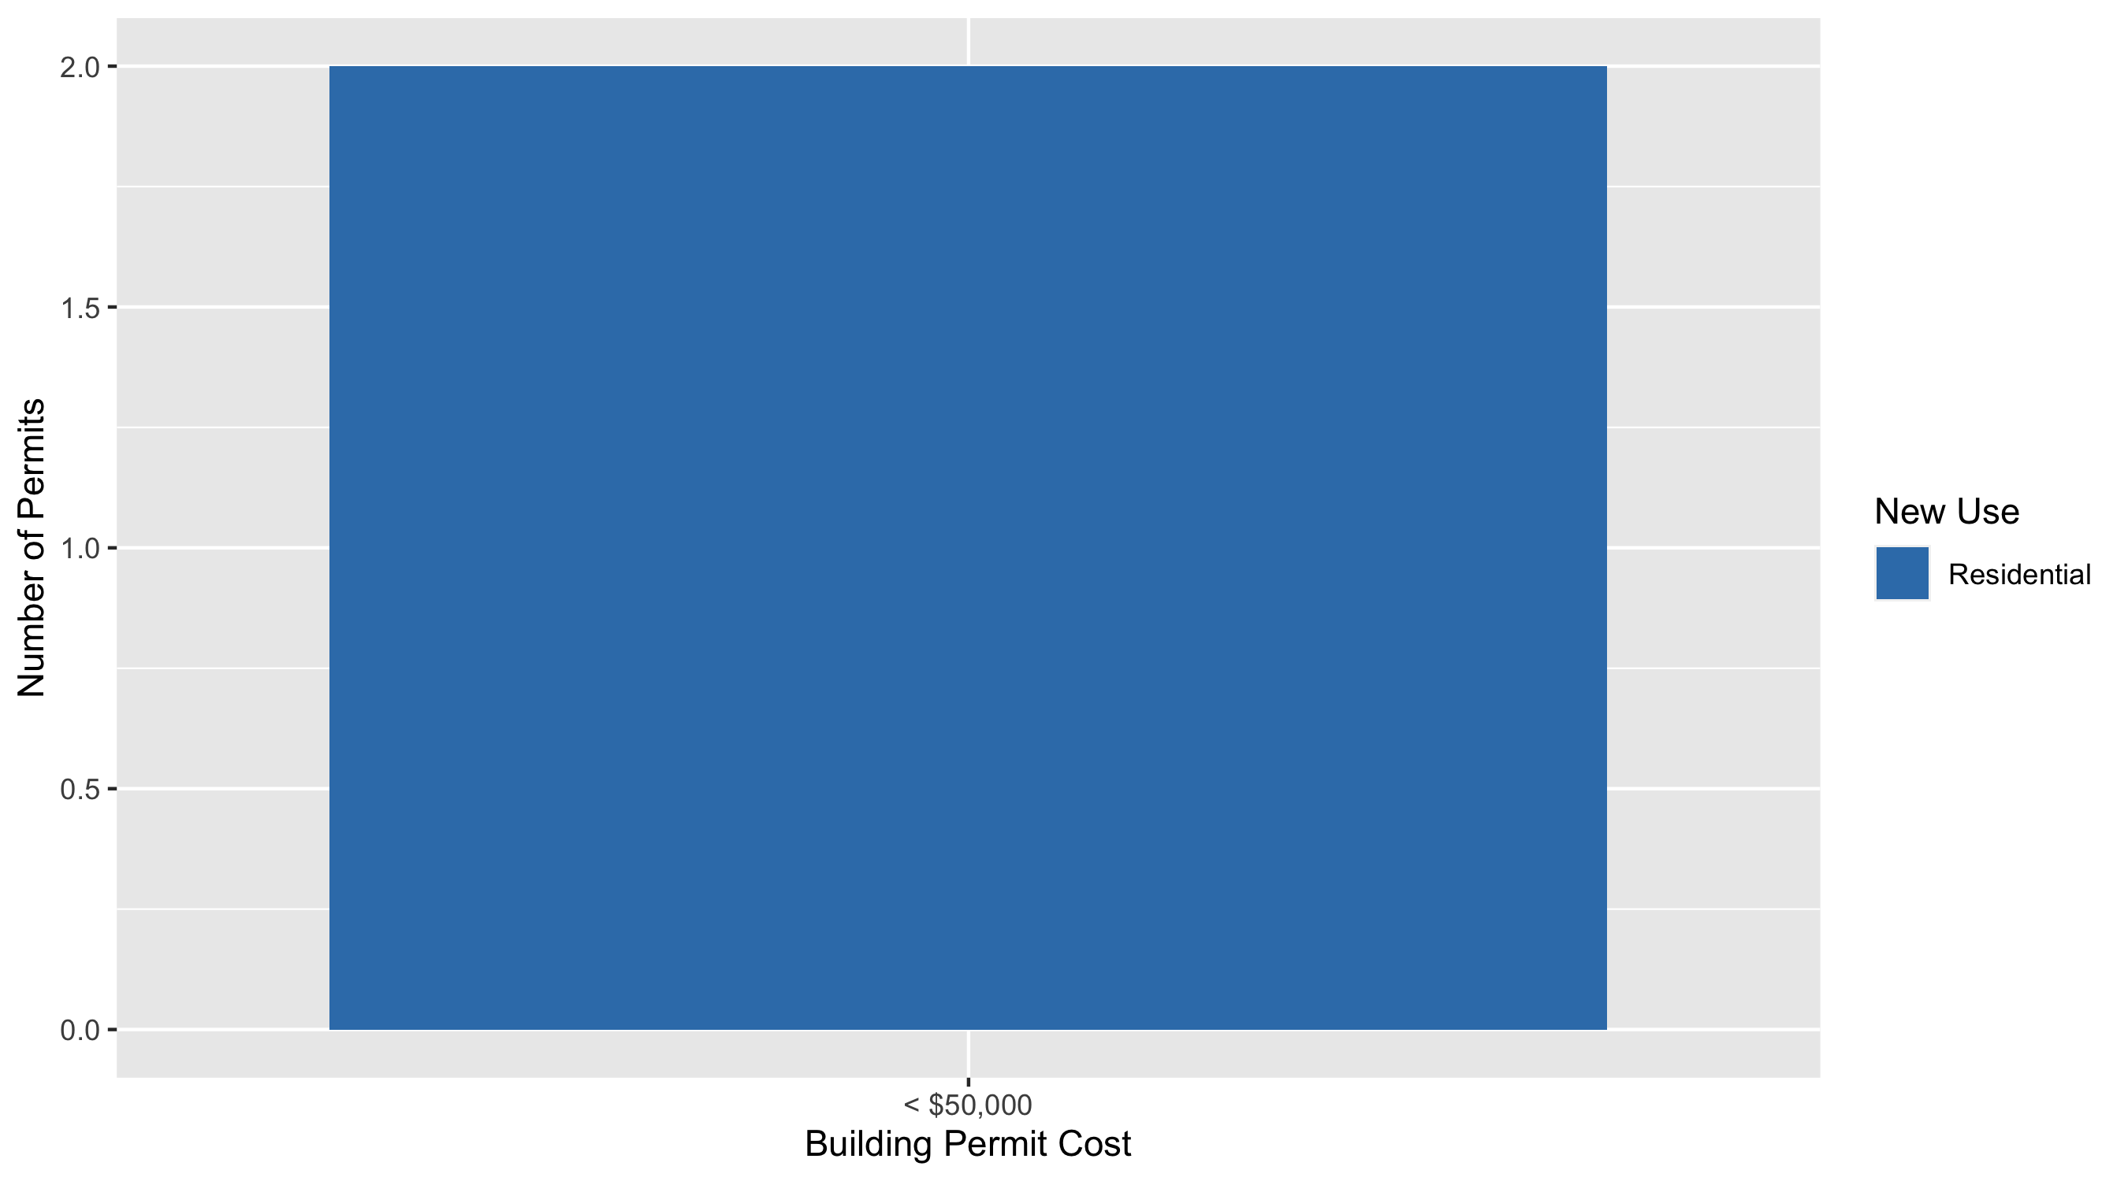
Academy Permit Cost Breakdown

Slide 39
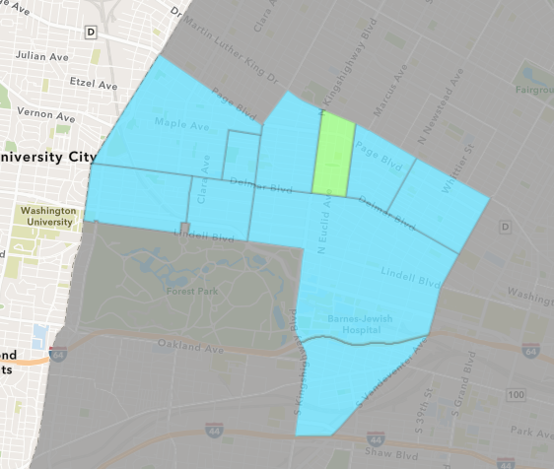
Fountain Park
April 2021 Neighborhood Cost Breakdown
Mean: $35,669
Median: $35,669
Range: $35,669 - $35,669

Slide 40
Fountain Park: Summary Notes
1 building permits in April 2021
0.00% change compared to April 2020 (1 total building permits)
$35,669: Average building permit cost in April 2021
3466.90% change compared to April 2020 ($1,000)
11 total building permits in 2021
450.00% change YTD compared to this time in 2020 (2 total building permits)
$584,933: YTD average building permit cost in 2021
38895.54% change YTD compared to this time in 2020 ($1,500)

Slide 41
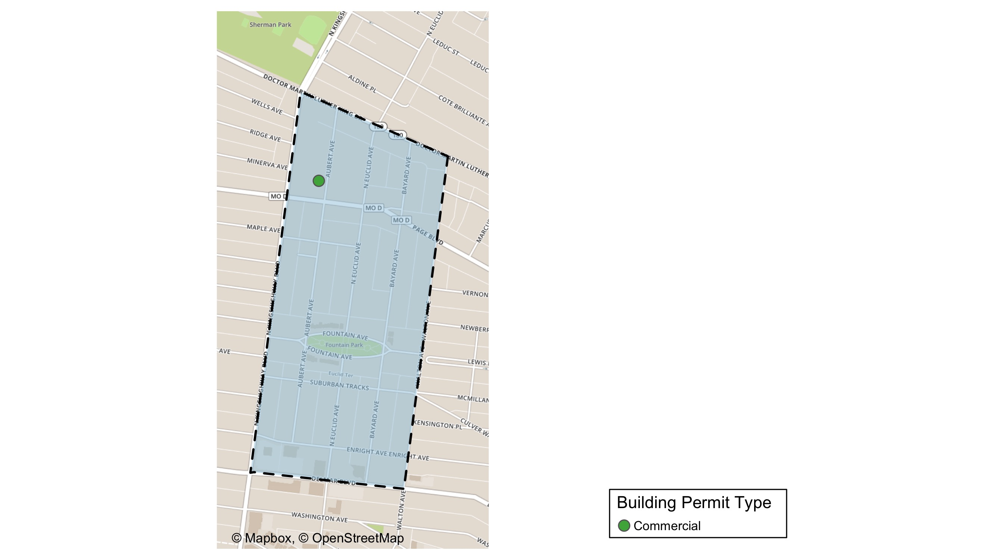
Fountain Park

Slide 42
Neighborhood Summary
April 2021 | April 2021 | April 2021 | April 2021
Permit Use | Average Cost | # of Permits | Total Value of Permits
Commercial | $35,669 | 1 | $35,669
Industrial | $0 | 0 | $0
Institutional | $0 | 0 | $0
Residential | $0 | 0 | $0
Last 6 Months | Last 6 Months | Last 6 Months | Last 6 Months
Permit Use | Average Cost | # of Permits | Total Value of Permits
Commercial | $1,070,794 | 6 | $6,424,764
Industrial | $0 | 0 | $0
Institutional | $0 | 0 | $0
Residential | $1,900 | 5 | $9,500

Slide 43
Fountain Park Individual Permit Breakdown
Owner | New Use | Cost | address
ROBERTS PLAZA LLC | Commercial | $35,669 | 1315 AUBERT AV

Slide 44
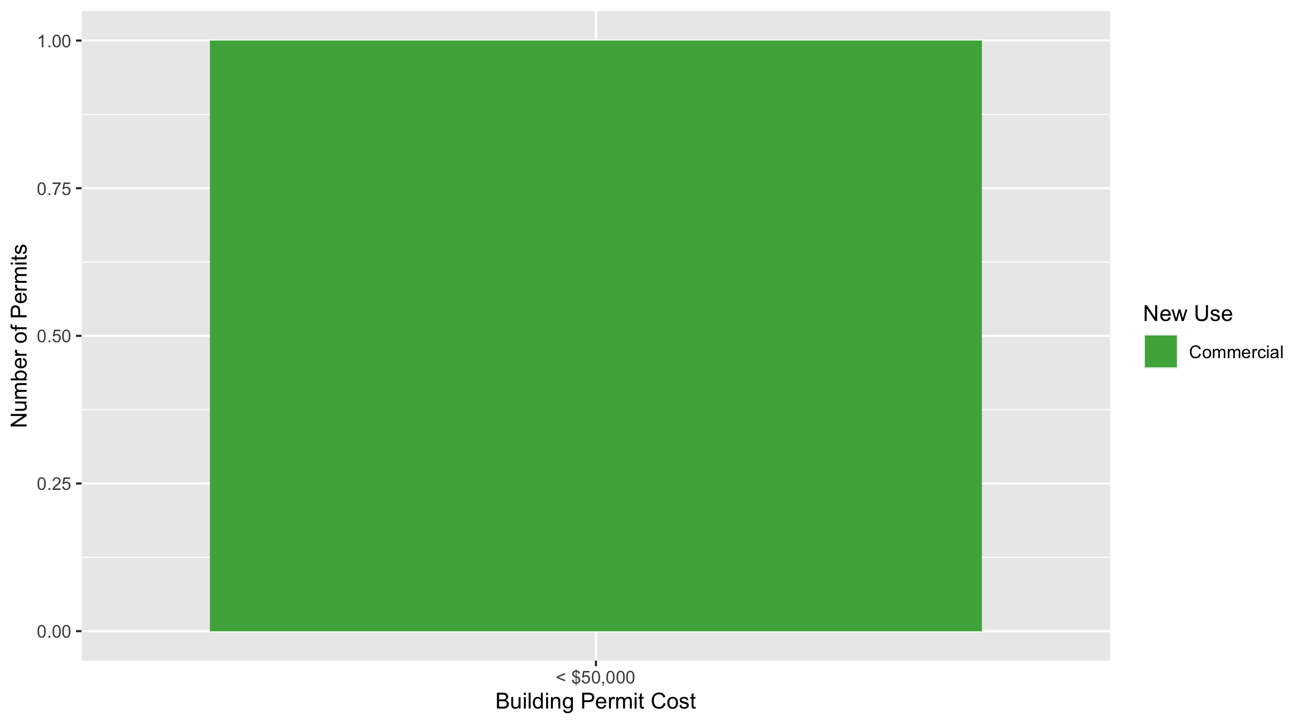
Fountain Park Permit Cost Breakdown

Slide 45
Additional Notes
Data retreived from https://www.stlouis-mo.gov/data/
Building permits with a cost of $0 were dropped
Building permits that were cancelled were dropped
Infinite change indicates 0 permits in the current or previous time period/comparison month so there was a overall increase or decrease

